Slide 1




A Social Initiative by
Smart Farming
Team Name: The Innovators
Team members:
P.Pallavi,
G.NavyaSree,
S.Umme Neeha,
K.Pranathi
College/Event: Make-a-thon 2025-Madanapalle Institute of
Technology and Science
MAKEFORMADANAPALLE
Project
Submission
23TH & 24TH OCTOBER
Ecosystem Development Partners

Slide 2


A Social Initiative by
Smart Farming
The Innovators
Challenge
“Farmers in Madanapalle struggle to identify crop diseases early and choose the right pesticide, leading to reduced yield and increased losses.”

Slide 3
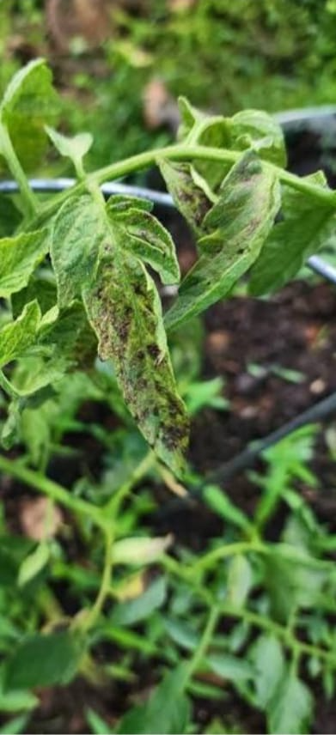
A Social Initiative by
A Social Initiative by
Problem we are trying to solve
“We aim to help farmers quickly detect crop diseases and recommend the correct Fertilizers or organic treatment, reducing crop loss, chemical misuse, and improving yield and income.”

Slide 4
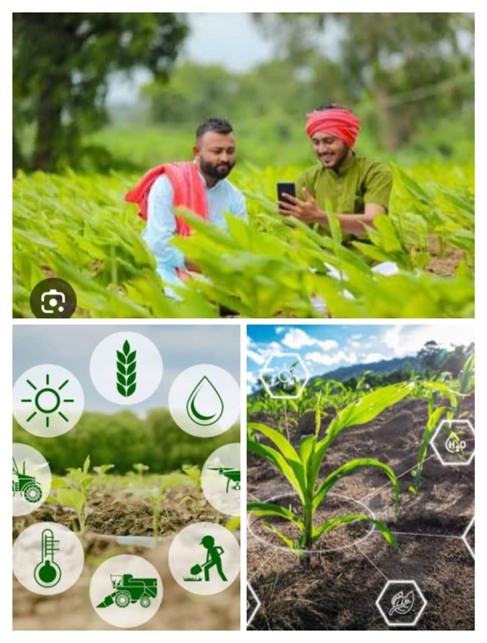
A Social Initiative by
Smart farming starts with
smart scanning
Our project Smart Farming is a web-based tool developed using VS Code and HTML to help farmers detect crop diseases and get pesticide suggestions. It allows users to scan or upload leaf images, identifies the disease, and recommends suitable treatments quickly and accurately through a simple interface.

Slide 5
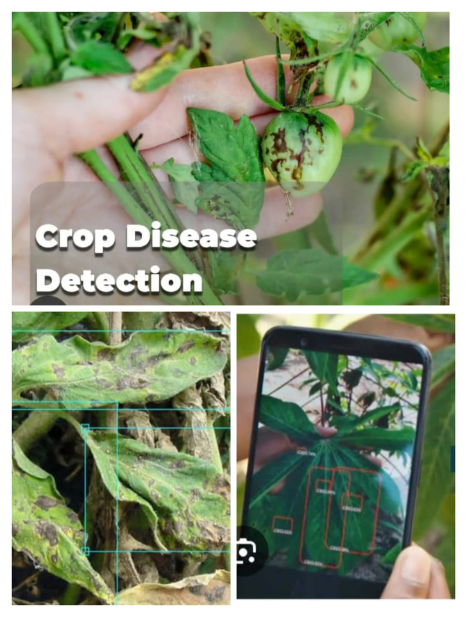
A Social Initiative by
Smart Crop Disease Detection
Smart Farming– Smart Crop Scanner is a user-friendly web application developed using VS Code and HTML that helps farmers identify crop diseases by scanning or uploading leaf images. It leverages an AI model to accurately detect diseases and instantly suggests the most effective chemical and organic pesticide treatments. The system also provides results in Telugu voice and text, ensuring accessibility for local farmers. Its lightweight, web-based design makes it easy to use on basic devices without complicated installations. This smart tool empowers farmers to protect their crops early, reduce losses, and increase yield efficiently.

Slide 6
A Social Initiative by
Social Impact
Who benefits from our solution?
Social Impact and Beneficiaries of smart farming
Smart farming is an AI-based web tool that helps small and marginal farmers in Madanapalle identify crop diseases quickly and get pesticide recommendations. Its simple interface and Telugu voice support also empower women farmers. Agricultural extension workers benefit by offering faster, accurate advice. Early disease detection increases crop yield and food security while reducing losses. Accurate pesticide guidance lowers costs and promotes sustainable farming by minimizing chemical use. By bridging technology and traditional farming, AgriScan improves farmer livelihoods and encourages eco-friendly agriculture.

Slide 7
A Social Initiative by
Impact & Next Steps
What changes if scaled?
If our Smart Crop Scanner is scaled across a larger region, such as all of Madanapalle, Annamayya district, or even Andhra Pradesh, it can transform agriculture in multiple ways. Early disease detection would reach thousands of farmers, allowing them to take prompt action and prevent widespread crop loss. Accurate pesticide recommendations on a large scale would reduce chemical misuse, protect soil health, and lower costs for farmers. Scaling the system would also generate a regional disease map, enabling predictive analytics for pest outbreaks and weather-related crop threats. Farmers could access guidance offline and in their local language, empowering even remote communities. Overall, scaling the project would increase crop yield, improve income, and promote sustainable farming, while integrating technology into everyday agriculture, creating a smarter, healthier, and more profitable farming ecosystem for the entire region.

Slide 8
Our Aspiration for this Project
Our aspiration for the Smart Crop Scanner project is to empower farmers, especially in regions like Madanapalle, with advanced, easy-to-use technology to manage their crops effectively. We aim to provide a system that allows farmers to detect crop diseases early, accurately identify pests, and receive correct pesticide or organic treatment recommendations. By making this tool accessible in local languages like Telugu and supporting offline functionality, we want to reach farmers in even the most remote areas. Beyond disease detection, we aspire to expand the system to cover more crops, integrate weather and pest prediction through IoT sensors, and create a community platform for sharing insights and solutions. Ultimately, we envision a future where smart technology improves yield, reduces chemical misuse, increases farmer income, and promotes sustainable agriculture, creating a smarter, safer, and more profitable farming ecosystem.

